Slide 1
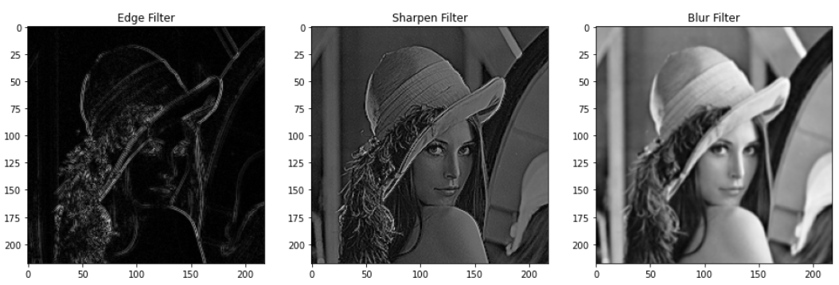
Lecture 1 Images and image filtering
Notes:
How about now?

Slide 2
Reading
Szeliski, Chapter 3.1-3.3

Slide 3

What is an image?
Notes:
First, we should talk about what an image is.

Slide 4

What is each part of an image?
Pixel -> picture element
‘138’
y
I(x,y)
x
Notes:
What is a pixel?

Slide 5
Image as a 2D sampling of signal
Signal: function depending on some variable with physical meaning.
Image: sampling of that function.
2 variables: xy coordinates
3 variables: xy + time (video)
‘Brightness’ is the value of the function for visible light
Can be other physical values too: temperature, pressure, depth …
Danny Alexander
Notes:
Danny Alexander, UCL

Slide 6
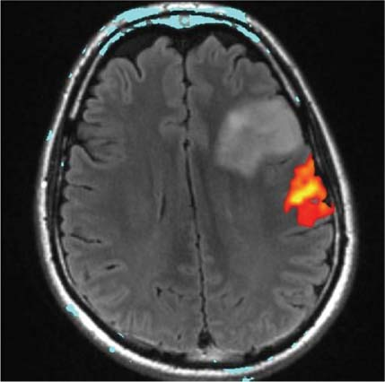
Example 2D Images
Danny Alexander
Notes:
fMRI - changes in blood flow in the brain associated with neural activity
http://radiologykey.com/wp-content/uploads/2016/01/9781604063325_c014_f004.jpg

Slide 7
Sampling in 1D
Sampling in 1D takes a function, and returns a vector whose elements are values of that function at the sample points.
Danny Alexander

Slide 8
Sampling in 2D
Sampling in 2D takes a function and returns a matrix.
Danny Alexander

Slide 9
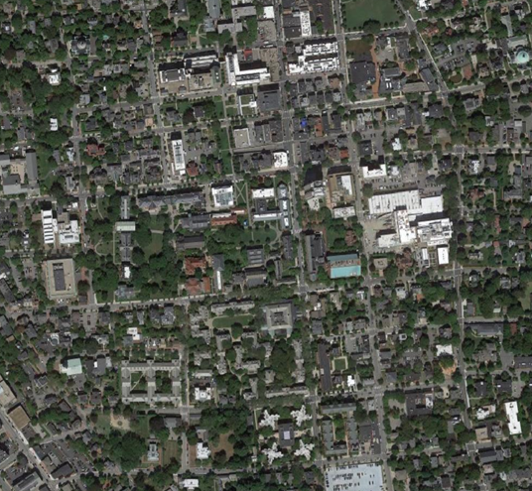
Grayscale Digital Image
Pixel -> picture element
‘127’
y
I(x,y)
x
Notes:
What is a pixel?

Slide 10
Grayscale Digital Image
Brightness
or intensity
x
y
Danny Alexander

Slide 11
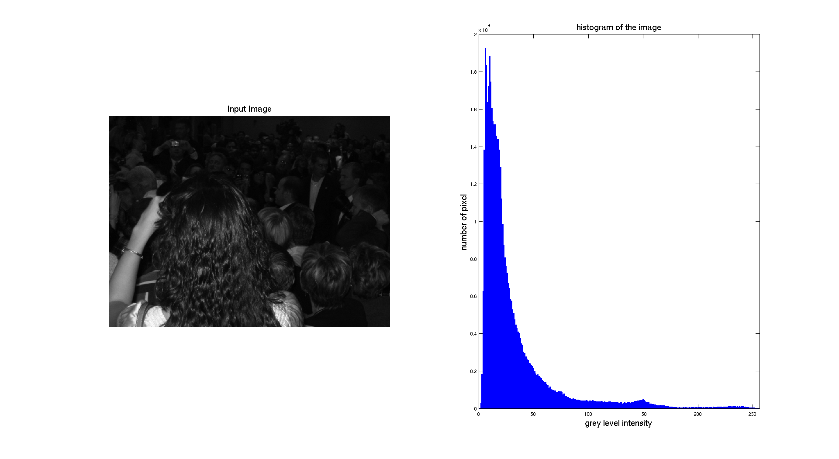
Image Histogram

Slide 12
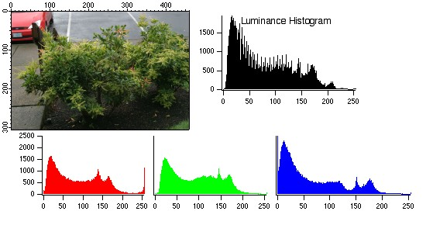
Image Histogram

Slide 13
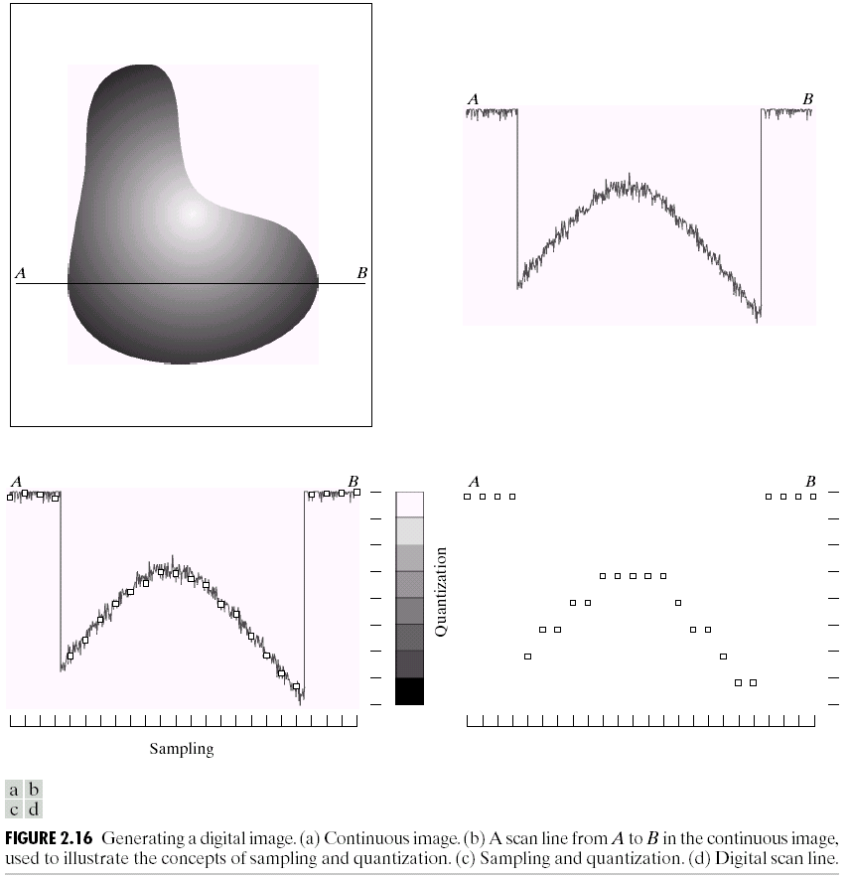
Quantization
Notes:
Real valued function will get digital values – integer values
• Quantization is lossy!!
– After quantization, the original signal cannot be reconstructed anymore
• This is in contrast to sampling, as a sampled but not quantized signal can be reconstructed.
• Simple quantization uses equally spaced levels with k intervals
Figure 2.16 from Szeliski textbook.

Slide 14
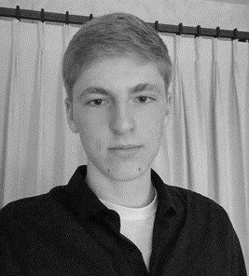
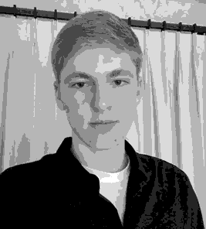

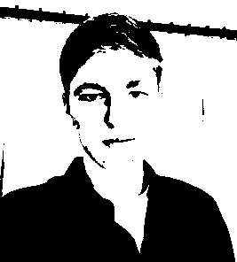
Quantization Effects – Radiometric Resolution
8 bit – 256 levels
4 bit – 16 levels
2 bit – 4 levels
1 bit – 2 levels

Slide 15


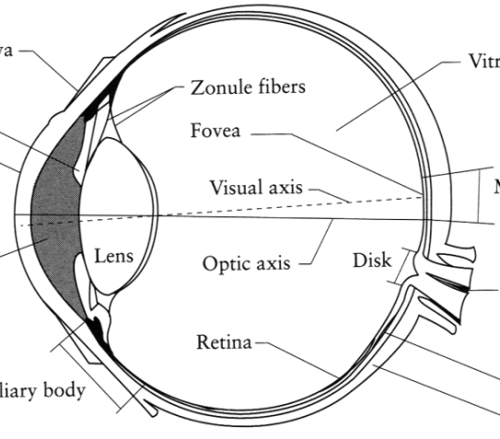
What is an image?
Digital Camera
We’ll focus on these in this class
(More on this process later)
The Eye
Source: A. Efros
Notes:
One way to think of an image is as a record of a set of light rays that bounce through space and hit a piece of light-sensitive film or a digital sensor.
Another way is to think of an image as just a grid of pixel values.
Another way is to think of an image as a response of our retinas to a light stimulus. In this class, we’ll focus on digital images. Later, we’ll come back to talk about how images are formed via the transmission of light through a scene.

Slide 16
What is an image?
A grid (matrix) of intensity values
(common to use one byte per value: 0 = black, 255 = white)
255 | 255 | 255 | 255 | 255 | 255 | 255 | 255 | 255 | 255 | 255 | 255
255 | 255 | 255 | 255 | 255 | 255 | 255 | 255 | 255 | 255 | 255 | 255
255 | 255 | 255 | 20 | 0 | 255 | 255 | 255 | 255 | 255 | 255 | 255
255 | 255 | 255 | 75 | 75 | 75 | 255 | 255 | 255 | 255 | 255 | 255
255 | 255 | 75 | 95 | 95 | 75 | 255 | 255 | 255 | 255 | 255 | 255
255 | 255 | 96 | 127 | 145 | 175 | 255 | 255 | 255 | 255 | 255 | 255
255 | 255 | 127 | 145 | 175 | 175 | 175 | 255 | 255 | 255 | 255 | 255
255 | 255 | 127 | 145 | 200 | 200 | 175 | 175 | 95 | 255 | 255 | 255
255 | 255 | 127 | 145 | 200 | 200 | 175 | 175 | 95 | 47 | 255 | 255
255 | 255 | 127 | 145 | 145 | 175 | 127 | 127 | 95 | 47 | 255 | 255
255 | 255 | 74 | 127 | 127 | 127 | 95 | 95 | 95 | 47 | 255 | 255
255 | 255 | 255 | 74 | 74 | 74 | 74 | 74 | 74 | 255 | 255 | 255
255 | 255 | 255 | 255 | 255 | 255 | 255 | 255 | 255 | 255 | 255 | 255
255 | 255 | 255 | 255 | 255 | 255 | 255 | 255 | 255 | 255 | 255 | 255
=

Slide 17
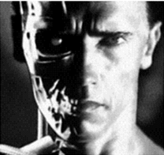
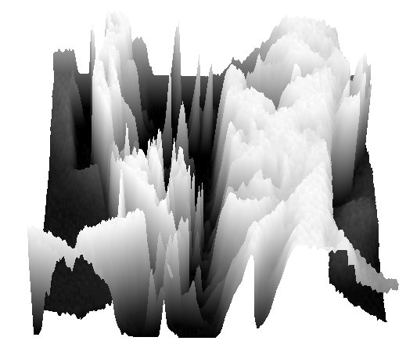
What is an image?
Can think of a (grayscale) image as a function f from R² to R:
f (x,y) gives the intensity at position (x,y)
A digital image is a discrete (sampled, quantized) version of this function
f (x, y)
x
y
Notes:
[Instructors note.] Here I show two demos.
One is “snoop” (https://www.csie.ntu.edu.tw/~cyy/projects/snoop/index.html), which is a Windows utility for zooming into the screen and showing the pixel values as numbers. So you can see brighter pixels have values close to 255, and darker pixels have values closer to 0. (Probably there exists some similar tool for Mac.)
The second demo is using Meshlab to open up a mesh that I’ve created to replicate an image, but where the “z” axis corresponds to intensity – really, just a visualization of the image as a function z = f(x,y). That mesh is here:
https://drive.google.com/open?id=1uJXcpQcWgRYlorrH_ctYn-yncEDvcxwV
If you look at it “head-on” it looks like the image of T100 above. If you move the viewpoint to the side, you see the image turn into hills and valleys. Bright regions are plateaus, dark regions are valleys, and “cliffs” represent edges in the image.

Slide 18
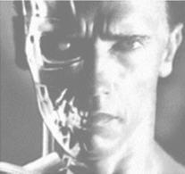
Image transformations
As with any function, we can apply operators to an image
Today we’ll talk about a special kind of operator, convolution (linear filtering)
g (x,y) = f (x,y) + 20
g (x,y) = f (-x,y)

Slide 19
Filters
Filtering
Form a new image whose pixel values are a combination of the original pixel values
Why?
To get useful information from images
E.g., extract edges or contours (to understand shape)
To enhance the image
E.g., to remove noise
E.g., to sharpen and “enhance image”
A key operator in Convolutional Neural Networks

Slide 20
Canonical Image Processing problems
Image Restoration
denoising
deblurring
Image Compression
JPEG, HEIF, MPEG, …
Locating Structural Features
corners
edges

Slide 21
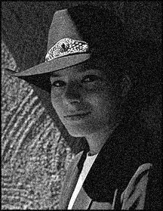
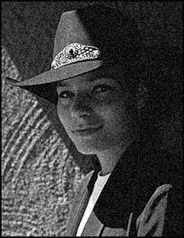

Question: Noise reduction
Given a camera and a still scene, how can you reduce noise?
Take lots of images and average them!
What’s the next best thing?
Source: S. Seitz
Notes:
Answer: take lots of images, average them

Slide 22
Image filtering
Modify the pixels in an image based on some function of a local neighborhood of each pixel
10
5
3
Some function
4
5
1
7
1
1
7
Local image data
Modified image data
Source: L. Zhang

Slide 23
Linear filtering
One simple version of filtering: linear filtering (cross-correlation, convolution)
Replace each pixel by a linear combination (a weighted sum) of its neighbors
The prescription for the linear combination is called the “kernel” (or “mask”, “filter”)
10
5
3
0
0
0
4
6
1
0
0.5
0
8
1
1
8
0
1
0.5
Local image data
kernel
Modified image data
[ ]
[ ]
[ ]

Slide 24
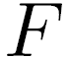
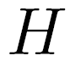

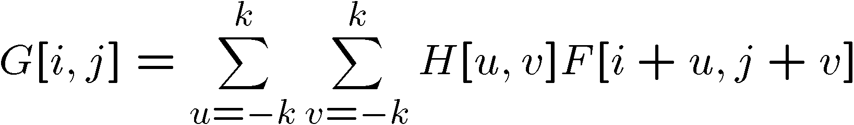
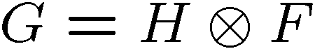
Cross-correlation
Let be the image, be the kernel (of size 2k+1 x 2k+1), and be the output image
Can think of as a “dot product” between local neighborhood and kernel for each pixel
This is called a cross-correlation operation:
[ ]
[ ]
[ ]

Slide 25
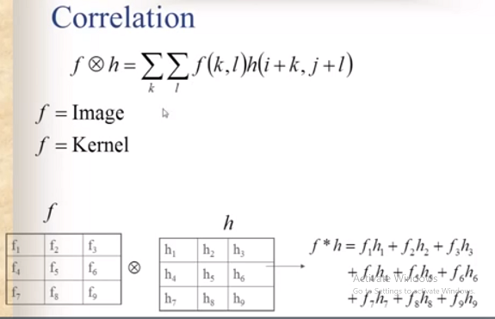
2d correlation
h

Slide 26
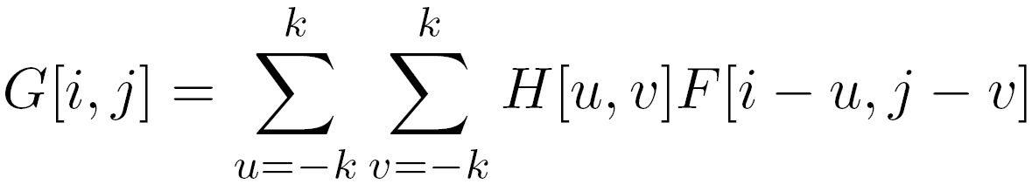
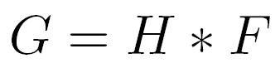
Convolution
Same as cross-correlation, except that the kernel is “flipped” (horizontally and vertically)
Convolution is commutative and associative
This is called a convolution operation:

Slide 27
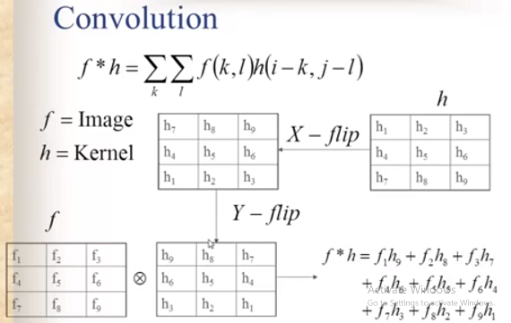
2d convolution
h
f

Slide 28



Convolution
Adapted from F. Durand

Slide 29

Mean filtering
0 | 0 | 0 | 0 | 0 | 0 | 0 | 0 | 0 | 0
0 | 0 | 0 | 0 | 0 | 0 | 0 | 0 | 0 | 0
0 | 0 | 0 | 90 | 90 | 90 | 90 | 90 | 0 | 0
0 | 0 | 0 | 90 | 90 | 90 | 90 | 90 | 0 | 0
0 | 0 | 0 | 90 | 90 | 90 | 90 | 90 | 0 | 0
0 | 0 | 0 | 90 | 0 | 90 | 90 | 90 | 0 | 0
0 | 0 | 0 | 90 | 90 | 90 | 90 | 90 | 0 | 0
0 | 0 | 0 | 0 | 0 | 0 | 0 | 0 | 0 | 0
0 | 0 | 90 | 0 | 0 | 0 | 0 | 0 | 0 | 0
0 | 0 | 0 | 0 | 0 | 0 | 0 | 0 | 0 | 0
 | 0 | 10 | 20 | 30 | 30 | 30 | 20 | 10
 | 0 | 20 | 40 | 60 | 60 | 60 | 40 | 20
 | 0 | 30 | 60 | 90 | 90 | 90 | 60 | 30
 | 0 | 30 | 50 | 80 | 80 | 90 | 60 | 30
 | 0 | 30 | 50 | 80 | 80 | 90 | 60 | 30
 | 0 | 20 | 30 | 50 | 50 | 60 | 40 | 20
 | 10 | 20 | 30 | 30 | 30 | 30 | 20 | 10
 | 10 | 10 | 10 | 0 | 0 | 0 | 0 | 0
*
=
1 | 1 | 1
1 | 1 | 1
1 | 1 | 1

Slide 30
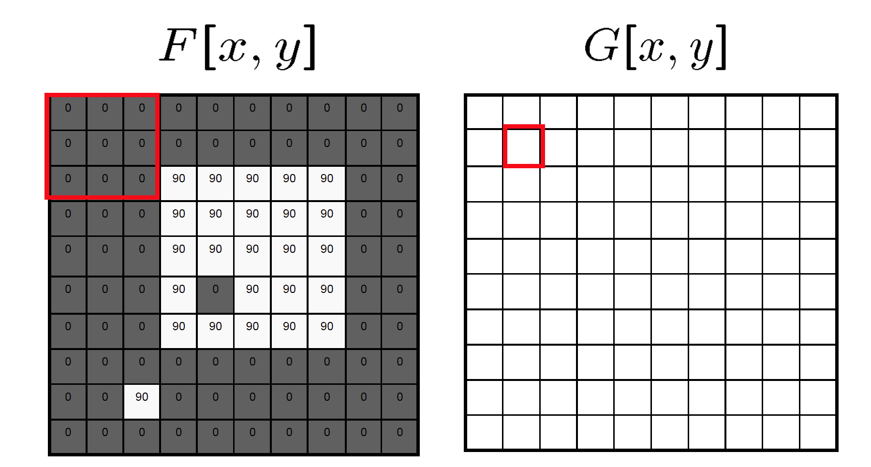
Mean filtering/Moving average

Slide 31
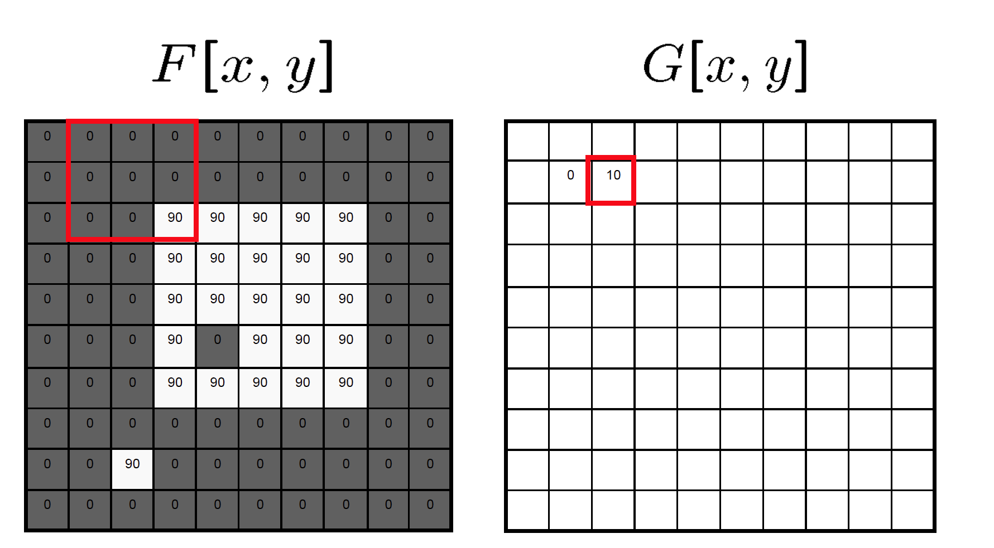
Mean filtering/Moving average

Slide 32

Mean filtering/Moving average

Slide 33
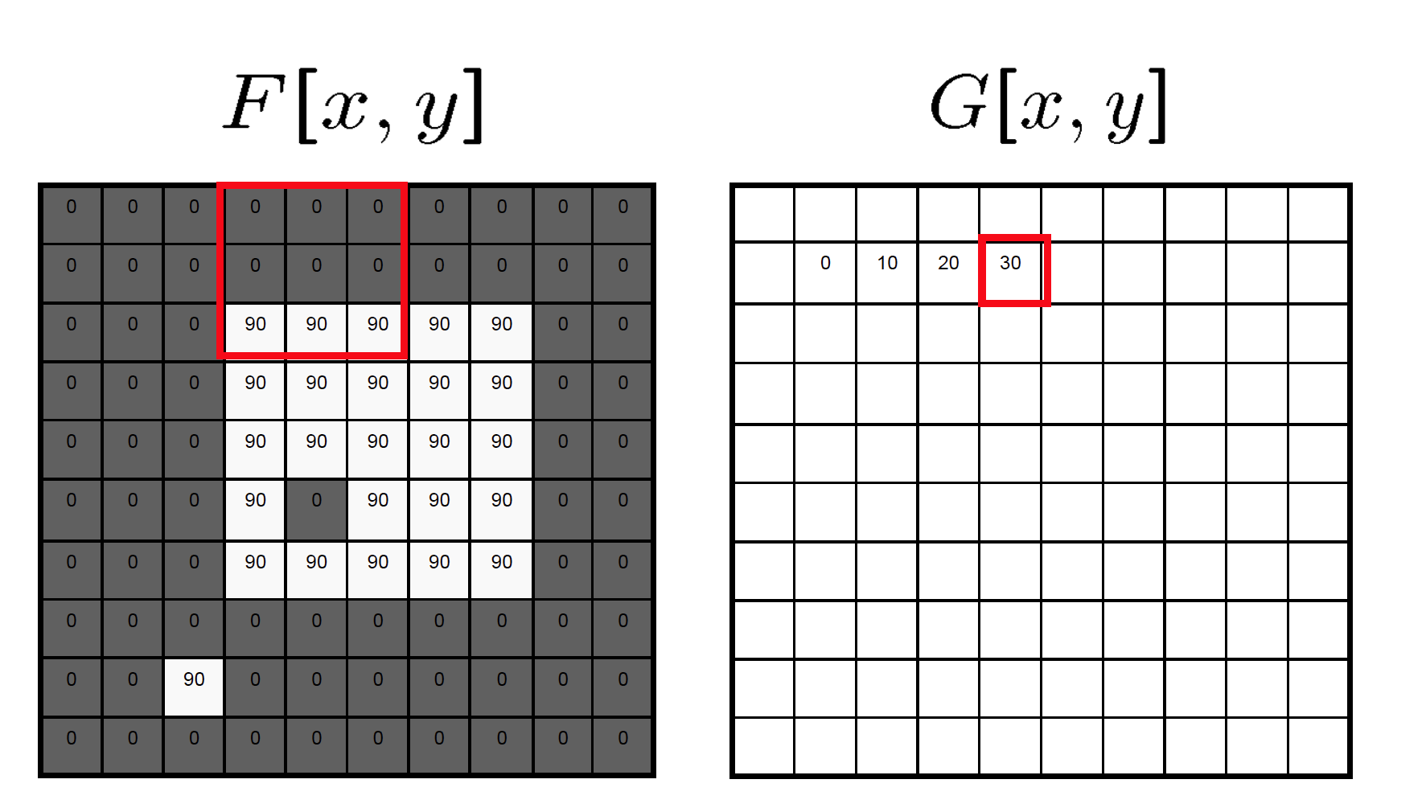
Mean filtering/Moving average

Slide 34
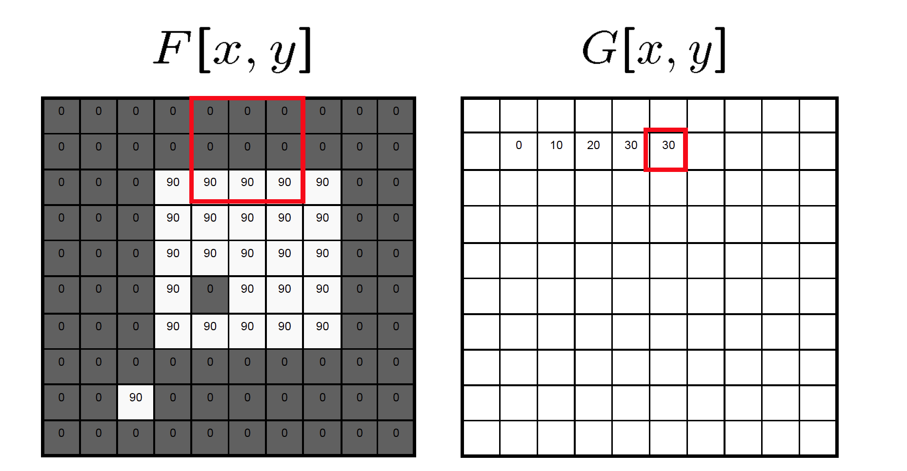
Mean filtering/Moving average

Slide 35
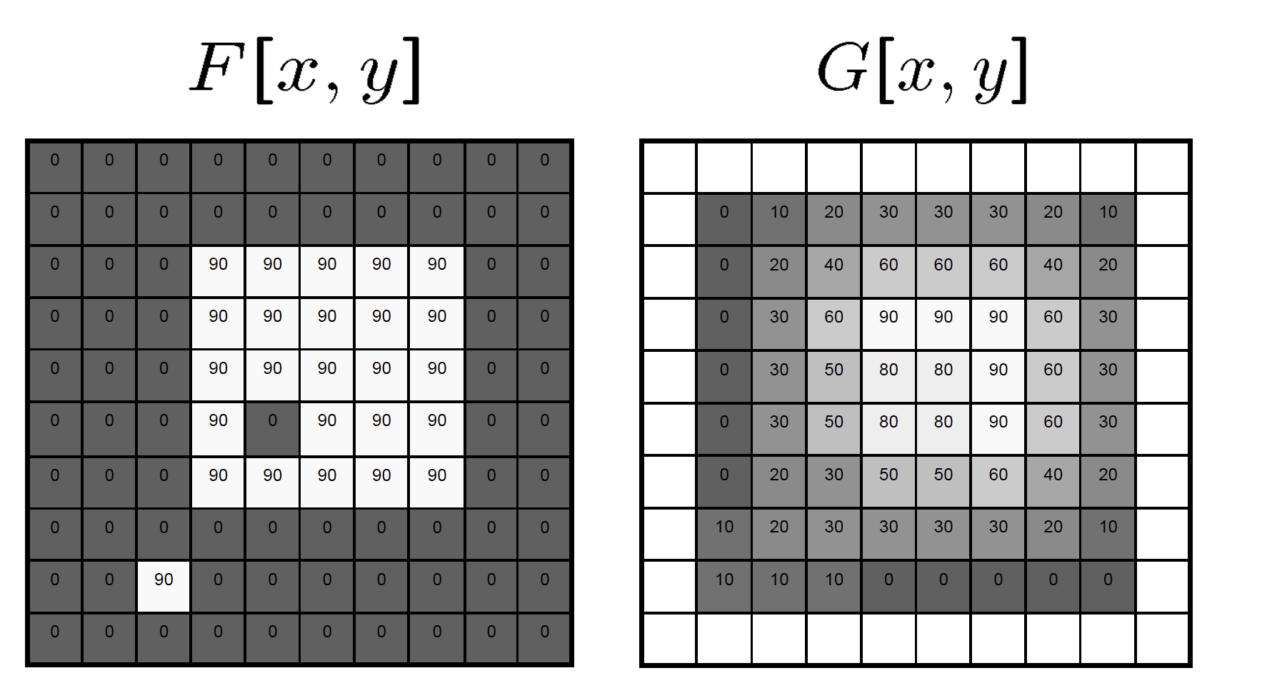
Mean filtering/Moving average

Slide 36
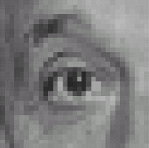
Linear filters: examples
*
0
0
0
0
1
0
0
0
0
Original
Source: D. Lowe

Slide 37


What image operation does filtering with this kernel perform? ([0 0 0; 0 1 0; 0 0 0])
ⓘ Start presenting to display the poll results on this slide.

Slide 38
Linear filters: examples
*
0
0
0
=
0
1
0
0
0
0
Original
Identical image
Source: D. Lowe

Slide 39
Linear filters: examples
*
0
0
0
1
0
0
0
0
0
Original
Source: D. Lowe

Slide 40
What image operation does filtering with this kernel perform? ([0 0 0; 1 0 0; 0 0 0])
ⓘ Start presenting to display the poll results on this slide.

Slide 41
Linear filters: examples
*
0
0
0
=
1
0
0
0
0
0
Original
Shifted left by 1 pixel
Source: D. Lowe

Slide 42
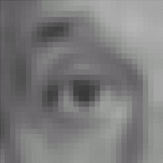

Linear filters: examples
*
1
1
1
=
1
1
1
1
1
1
Original
Blur (with a mean filter)
Source: D. Lowe

Slide 43
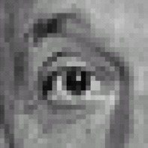



Linear filters: examples
*
0
0
0
-
1
1
1
=
0
2
0
1
1
1
0
0
0
1
1
1
Sharpening filter (accentuates edges)
Original
Source: D. Lowe

Slide 44
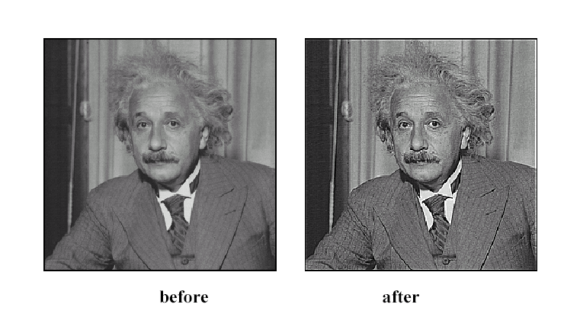
Sharpening
Source: D. Lowe

Slide 45
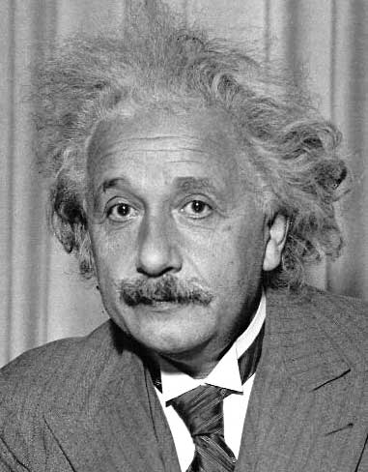
Linear filters: examples
1
0
-1
2
0
-2
1
0
-1
Sobel
Vertical Edge
(absolute value)
David Lowe

Slide 46
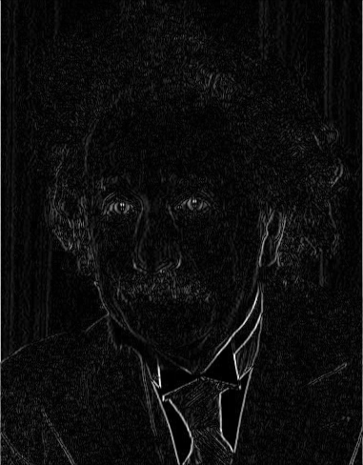
Linear filters: examples
1
0
-1
2
0
-2
1
0
-1
Sobel
Vertical Edge
(absolute value)
David Lowe

Slide 47
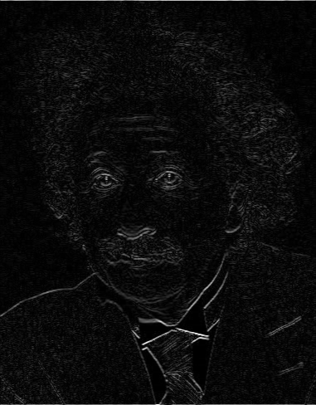
Linear filters: examples
1
2
1
0
0
0
-1
-2
-1
Sobel
Horizontal Edge
(absolute value)
David Lowe
Notes:
Questions at this point?

Slide 48
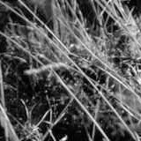
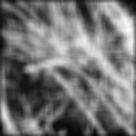
Smoothing with box filter revisited
Source: D. Forsyth
Notes:
I always walk through the argument on the left rather carefully; it gives some insight into the
significance of impulse responses or point spread functions.

Slide 49
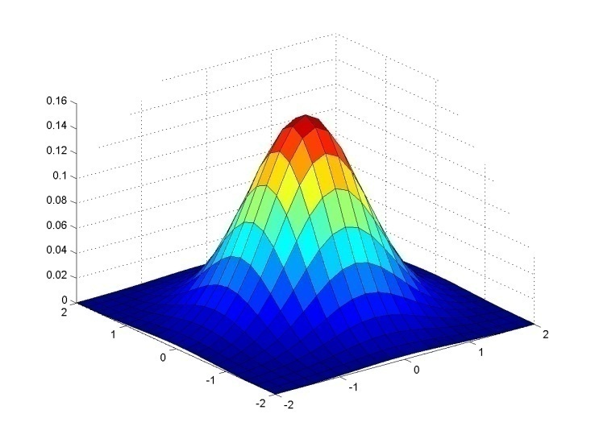
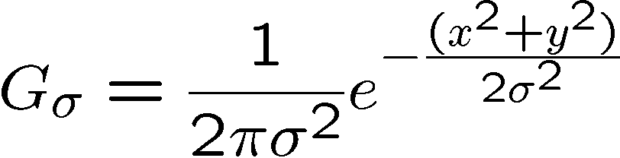
Gaussian kernel
Source: C. Rasmussen

Slide 50
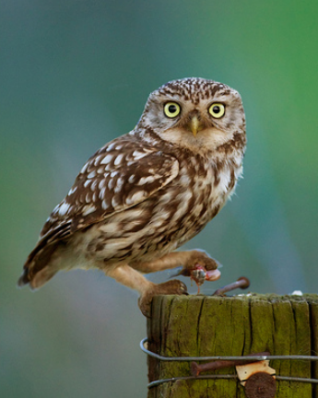









Gaussian filters
= 1 pixel
= 5 pixels
= 10 pixels
= 30 pixels

Slide 51
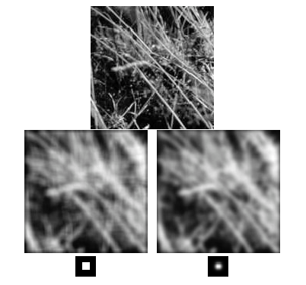
Mean vs. Gaussian filtering

Slide 52



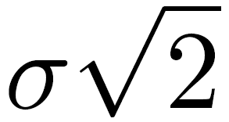
Gaussian filter
Removes “high-frequency” components from the image (low-pass filter)
Convolution with self is another Gaussian
Convolving twice with Gaussian kernel of width = convolving once with kernel of width
*
=
Source: K. Grauman
Notes:
Linear vs. quadratic in mask size

Slide 53
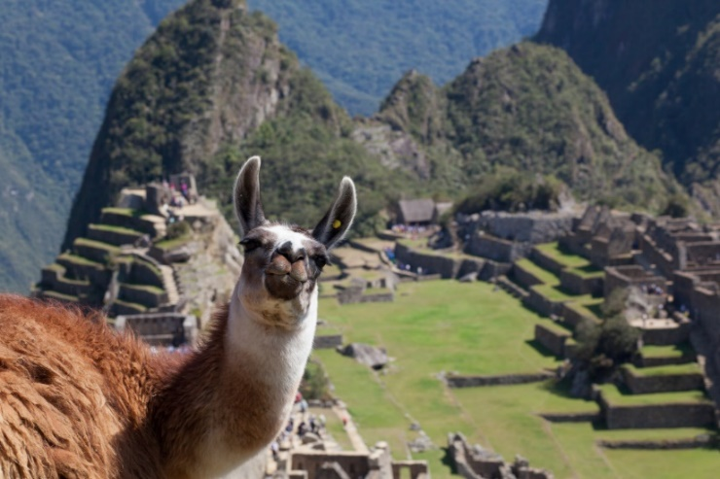

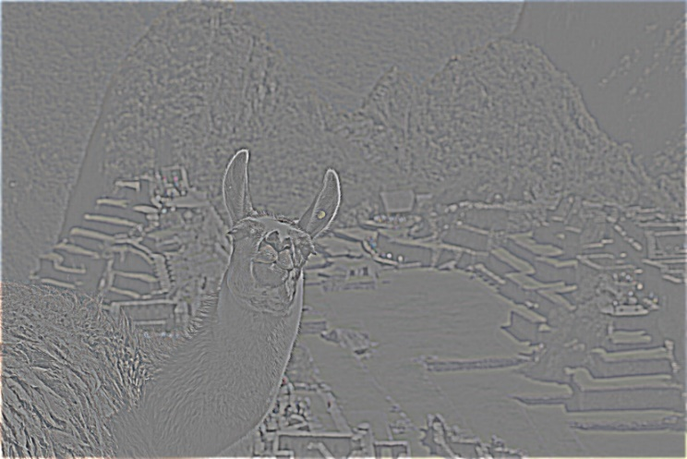
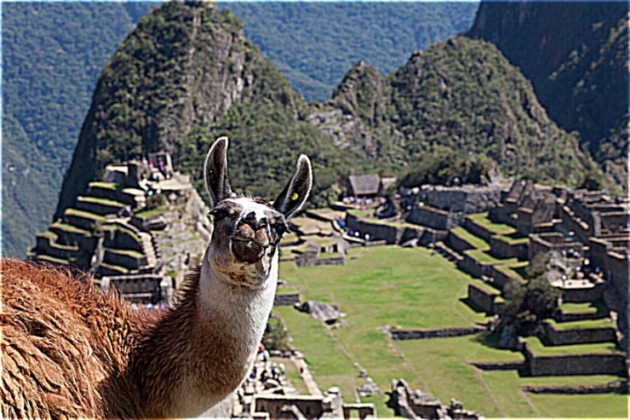
Sharpening revisited
What does blurring take away?
–
=
original
smoothed (5x5)
detail
(This “detail extraction” operation is also called a high-pass filter)
Let’s add it back:
+ α
=
original
detail
sharpened
Photo credit: https://www.flickr.com/photos/geezaweezer/16089096376/

Slide 54
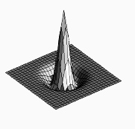

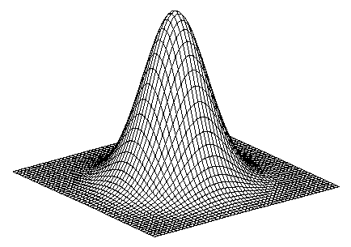
Sharpen filter
+
blurred image
image
unit impulse (identity kernel with single 1 in center, zeros elsewhere)
scaled impulse
Gaussian
Sharpen filter
Notes:
This slide derives a sharpen filter from the intuition in the previous slide – i.e., “sharpening is taking an image I, blurring it, subtracting the blurred image from I to get high-frequency edges, then scaling and adding those edges back to I to yield an image with emphasized edges).
f + a(f - f * g) = (1+a)f-af*g = f*((1+a)e-ag)

Slide 55

Sharpen filter
unfiltered
filtered
Notes:
Note how in sharpened region of the image (also known as “unsharp mask filtered” image), the edges are transformed so that the image gets darker on one side and brighter on the other – in this way, the edge is emphasized. The sharpened image “anticipates” the edges.

Slide 56
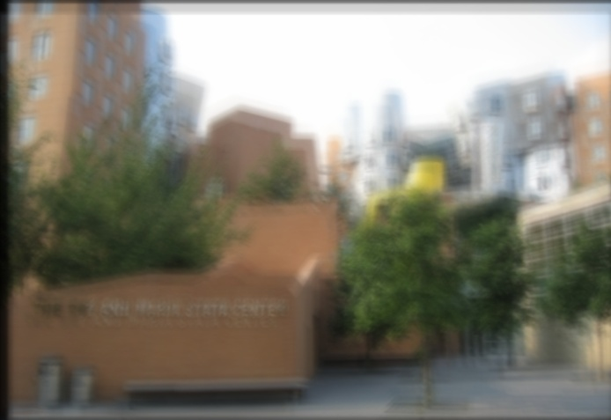
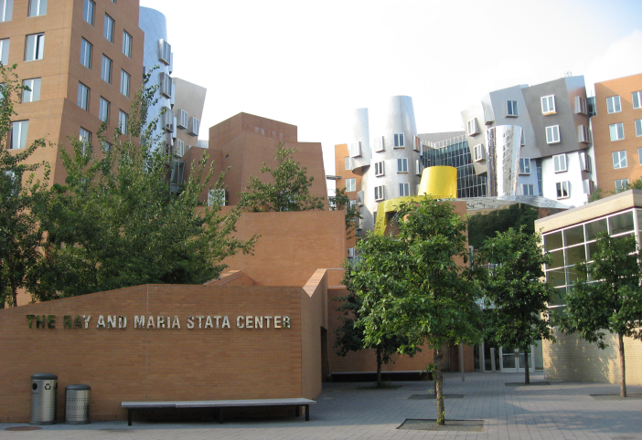
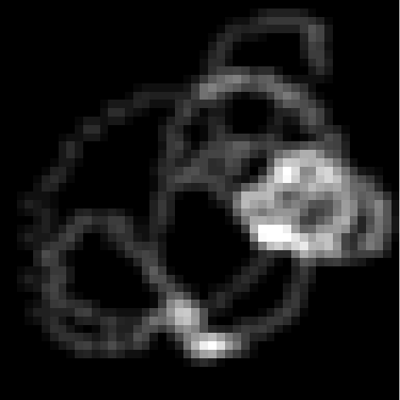




“Optical” convolution
Camera shake
=
*
Source: Fergus, et al. “Removing Camera Shake from a Single Photograph”, SIGGRAPH 2006
Bokeh: Blur in out-of-focus regions of an image.
Source: https://www.diyphotography.net/diy_create_your_own_bokeh/

Slide 57



Filters: Thresholding

Slide 58
Linear filters
Can thresholding be implemented with a linear filter?
Notes:
Answer: No.

Slide 59
Can thresholding be implemented with a linear filter?
ⓘ Start presenting to display the poll results on this slide.

Slide 60
Questions?

